Slide 1
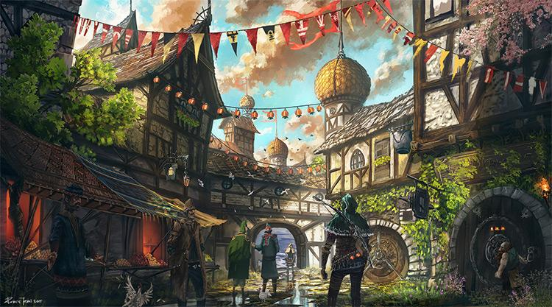
Chatbot Town
Christopher Pang
Jeffery Ott

Slide 2
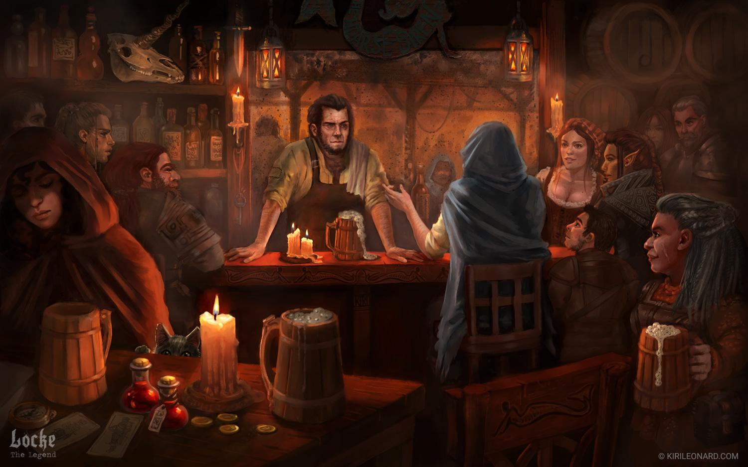
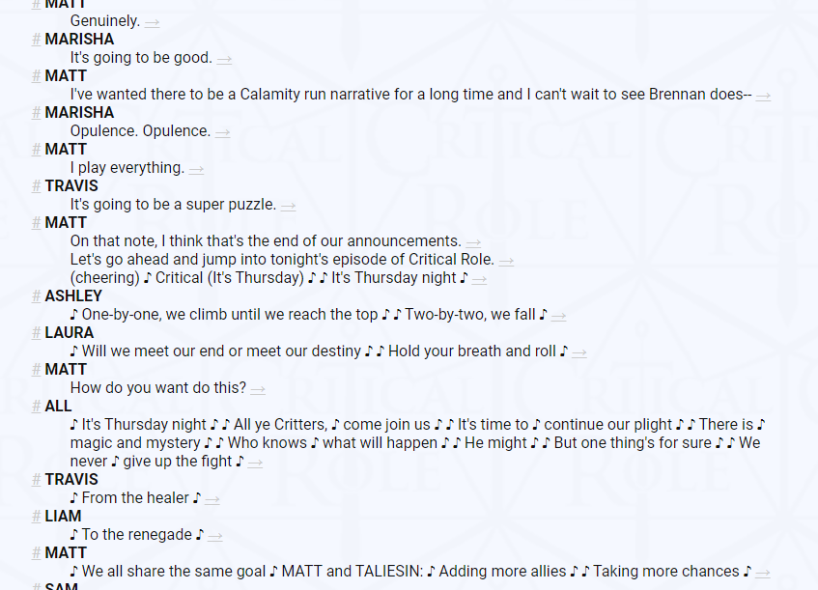
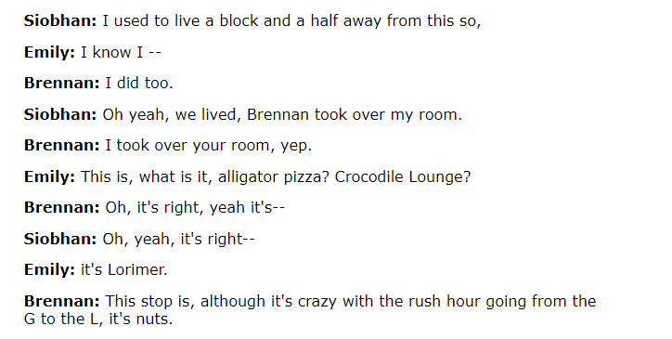
“Where am I going to get the data for this project?”
We are going to grab the data for ourselves using multi person podcasts based around DND Thousand of hours of fantasy conversation in reply-response format
Notes:
Have 2 person dataset vs more than 2?

Slide 3
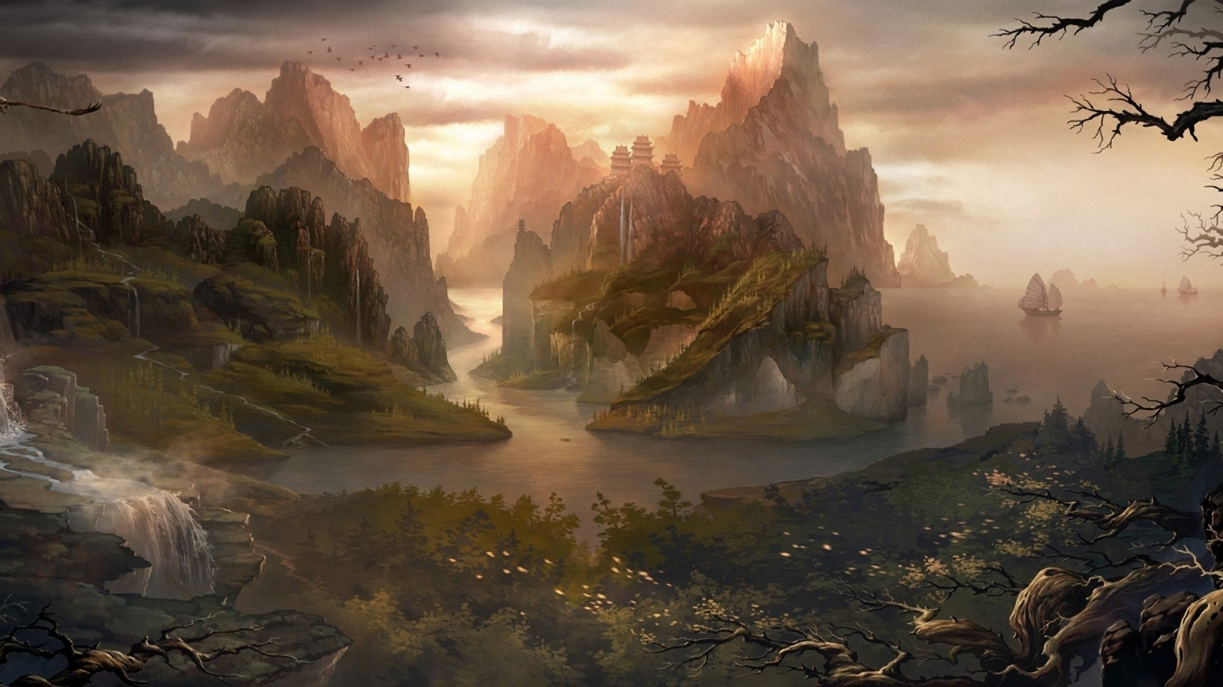
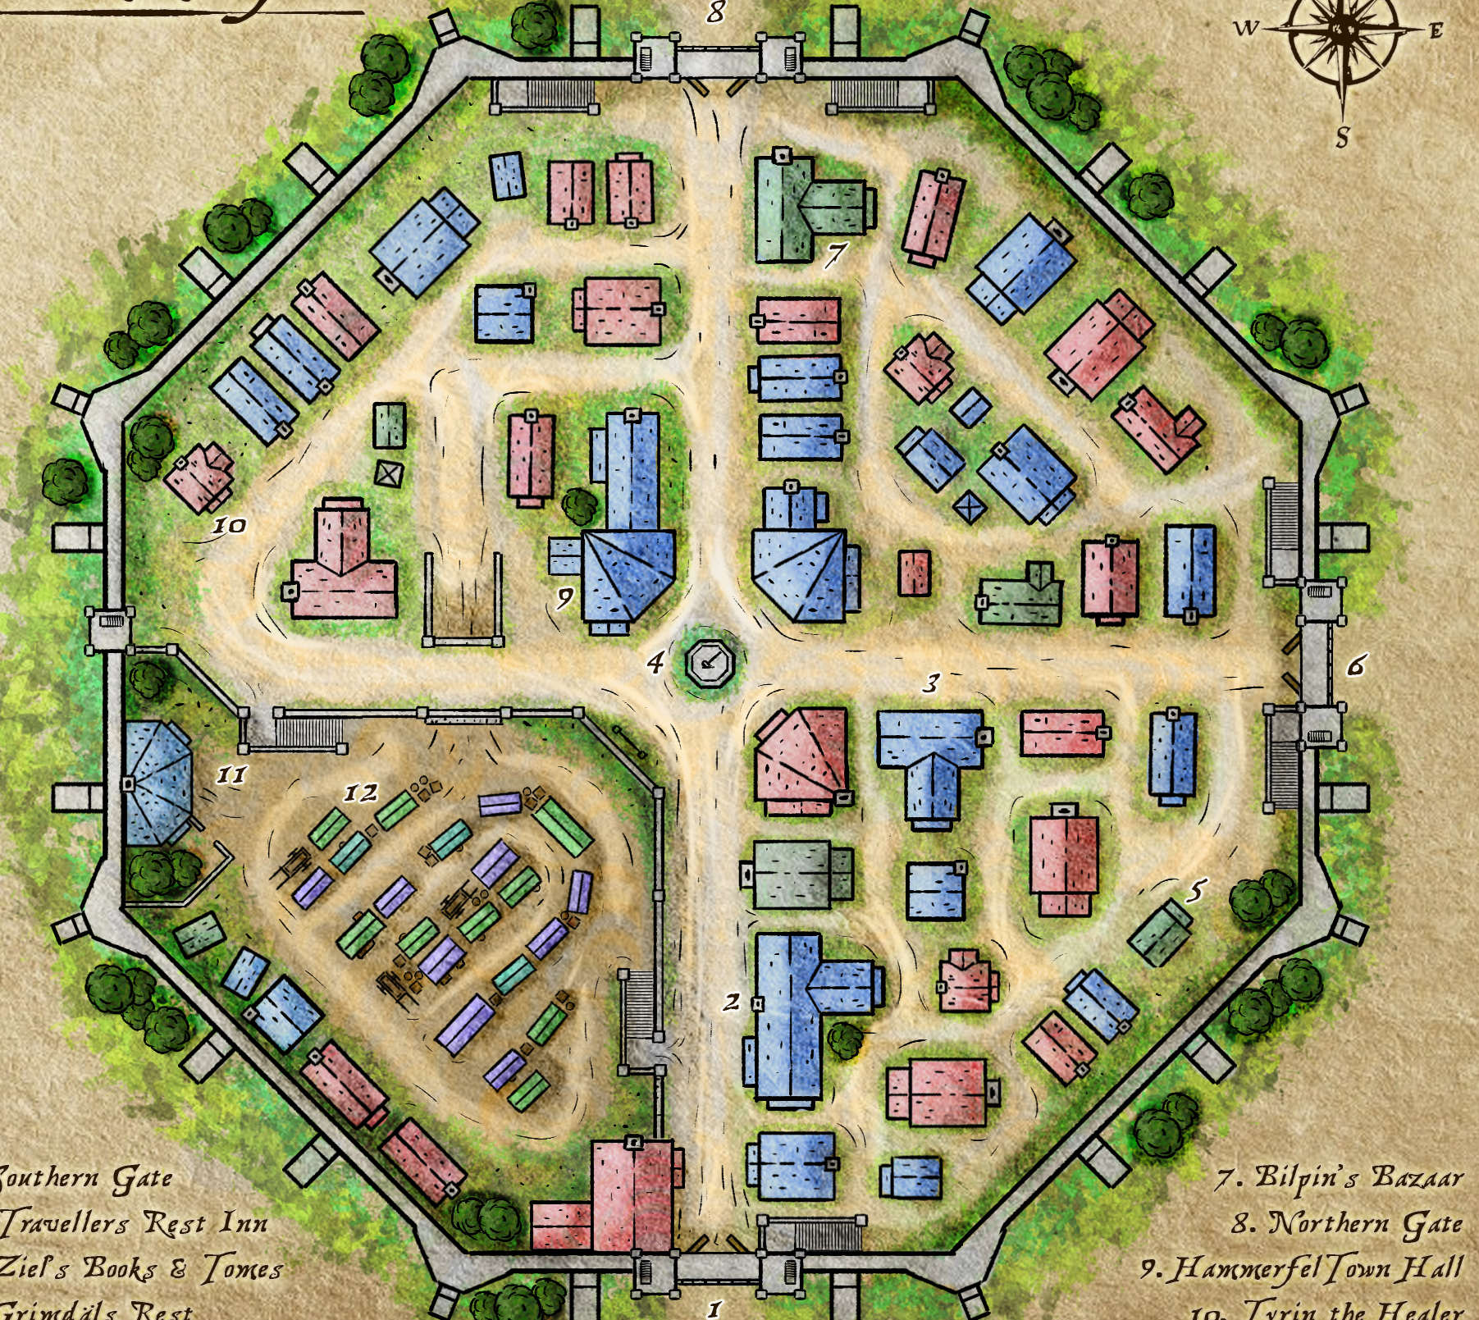
What does this look like?
Each bot is trained on a different character corpus
During the “day” the bots move randomly around the “town” and have conversations whenever they interact, these conversations are stored
During the night we retrain on these conversations and see what happens

Slide 4
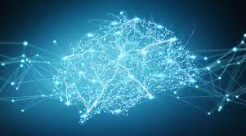
“How is deep learning used in this project?”
This is an NLP focused project where we will utilize several Deep learning technologies (including but not limited to)
Pre-processing pipeline
Train Seq2Seq model/transformers on our custom dataset
Pytorch
Comparison of deep learning versus baseline chatterbot library
Notes:
that uses search/classification algorithms
https://chatterbot.readthedocs.io/en/stable/faq.html
1. Search algorithms
Searching is the most rudimentary form of artificial intelligence. To be fair, there are differences between machine learning and artificial intelligence but lets avoid those for now and instead focus on the topic of algorithms that make the chat bot talk intelligently.
Search is a crucial part of how a chat bot quickly and efficiently retrieves the possible candidate statements that it can respond with.
Some examples of attributes that help the chat bot select a response include
the similarity of an input statement to known statements
the frequency in which similar known responses occur
the likeliness of an input statement to fit into a category that known statements are a part of
2. Classification algorithms
Several logic adapters in ChatterBot use naive Bayesian classification algorithms to determine if an input statement meets a particular set of criteria that warrant a response to be generated from that logic adapter.
Next Previous

Slide 5
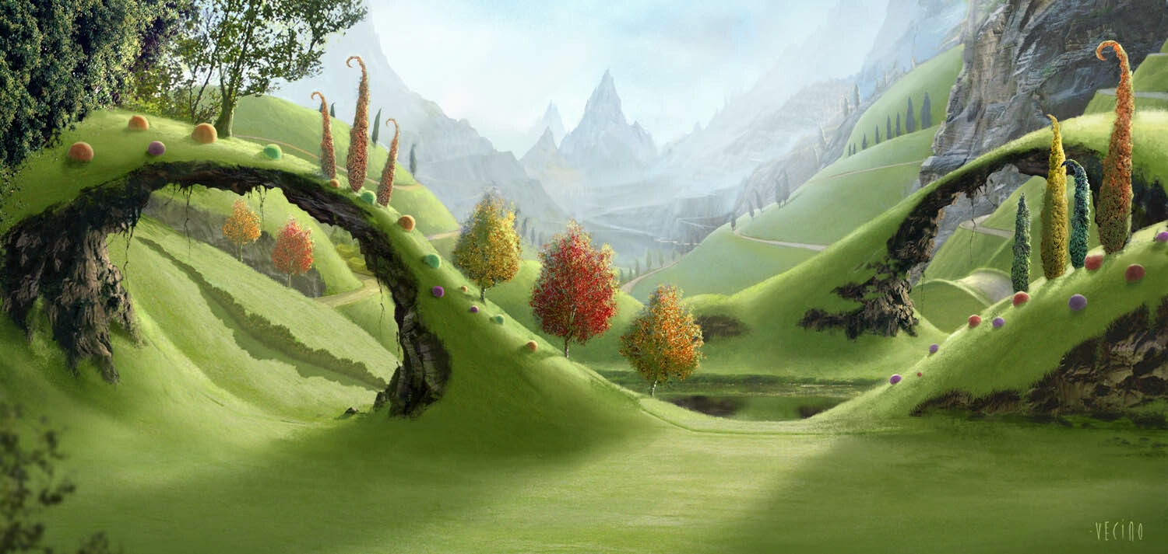
Project roadmap
Find and Prepare data
Creating a program to parse those podcast transcript
Deploy in ‘town’
Pre Process data
Random walk bots around town and have convos with each other
Tokenize
Stemming
Lemmatizing
Parse trees
Word Vectors and model
Select Type
Build a seq2seq model or use chatterbox library
Generative bot if have time; retrieval if dont have time
Notes:
Retrieval is canned responses from database
Generative is bot stitches words together

